Slide 1
Analysis for Dataset ‘Infrared Thermography’
799 DSAN Capstone Project Zhen Li
Ferris State University

Slide 2
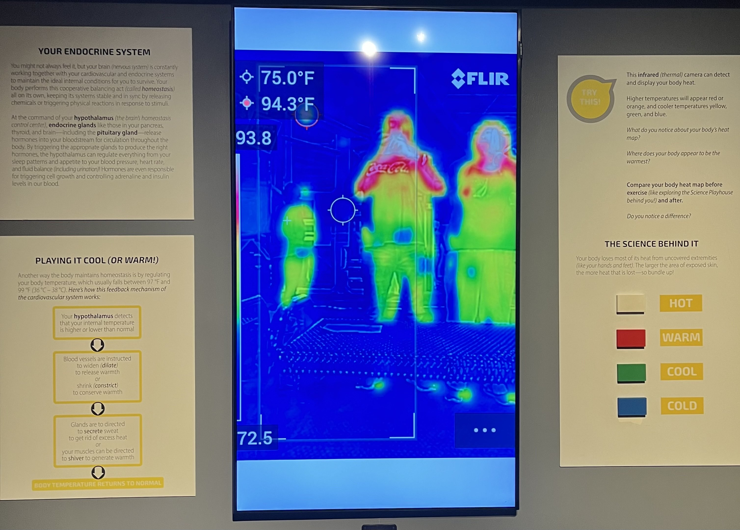
Background
Figure 1

Slide 3
Data Source
The original dataset, FLIR_groups1and2.csv, is available for download at https://doi.org/10.13026/3bhc-9065 (Wang et al. 2023).
This file contains 1,020 observations and 120 variables.
For this project, which aims to develop a model for rapid screening, we have retained 32 variables from the first round of measurements, focusing on infrared thermography and environmental parameters, for our analysis.

Slide 4
Variables list
Variable Name | Role | Type | Description
SubjectID | ID | Categorical | Subject ID
T_OR_Max1 | Target | Continuous | Oral temperature
Gender | Feature | Categorical | Male or Female
… | … | …
… | … | …
T_Max1 | Feature | Continuous | Maximum temperature within the whole face region

Slide 5
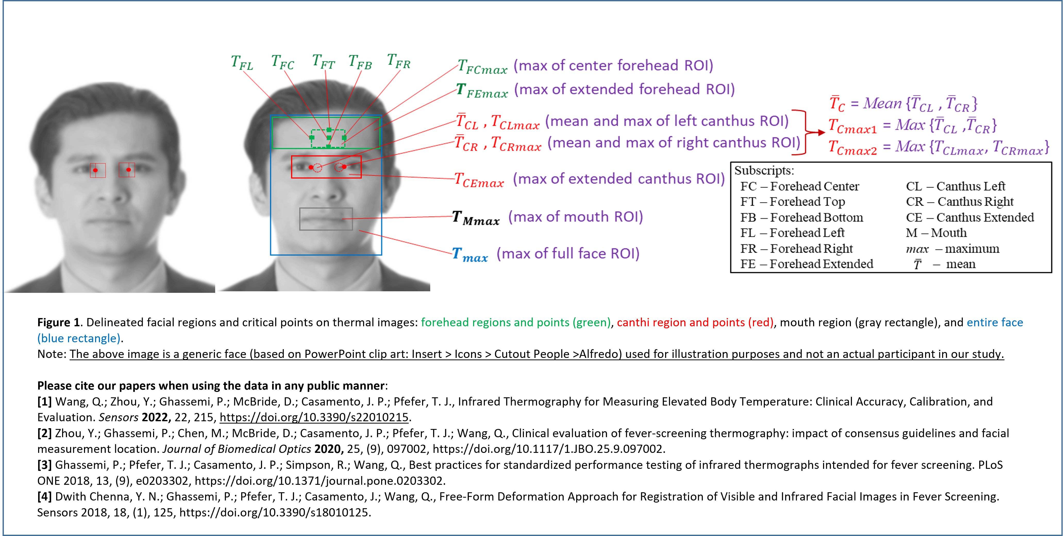
Measure Guidance
Figure 2
Measurement guidance

Slide 6
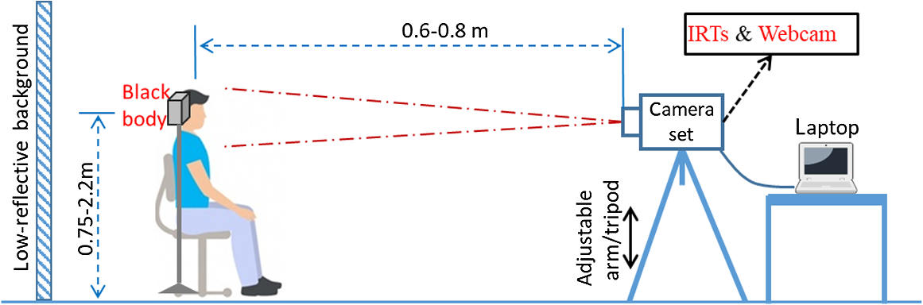
Measure Guidance continued
Figure 3
Mesurement guidance02

Slide 7
The R Packages Used
tidyverse Data manipulation, visualization, importing, and cleaning Hmisc Data analysis, imputing missing data, and advanced graphics psych Multivariate analysis, reliability analysis, and factor analysis scales Transformations and formatting of data for plots caTools Splitting data, moving averages, and running ROC curves patchwork Creating complex layouts by combining multiple ggplot2 plots car Regression diagnostics, ANOVA, and data visualization reshape2 Reshape data between wide and long formats caret Data splitting, pre-processing, model tuning, and variable importance glmnet Regularization and variable selection (Ridge regression) gridExtra Combining multiple plots into a single graphical output

Slide 8
Brief Look at the Selected Data
There are a total of 32 variables and 1,020 observations.
Some variables, such as ‘T_offset1’, have missing values.
Some categorical data, like ‘Age’, have overlapping ranges such as ‘21-25’, ‘26-30’, and ‘21-30’, which should be combined into a single group to reduce complexity.

Slide 9
Dealing the Missing Data and Combine Age Group
# Convert all empty strings to NA data_selected[data_selected == ""] <- NA # Remove rows with any NA values data_cleaned <- data_selected[complete.cases(data_selected), ] # combine age 21-30 to one group data_cleaned$Age[data_cleaned$Age == "21-25" | data_cleaned$Age == "26-30"] <- "21-30" data_cleaned$Age[data_cleaned$Age == ">60" ] <- "60+" # Hmisc::describe(data_cleaned)

Slide 10
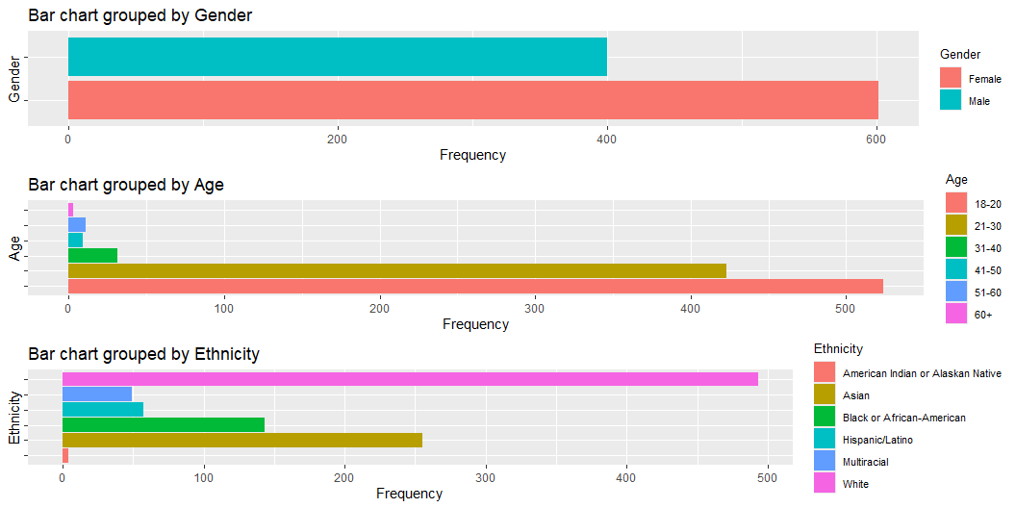
Plot Categorical Data

Slide 11
Process with Categorical Data to Numerical
mydataframe <- data_cleaned %>% mutate( # Encoding categorical variables # Gender_Female as base line Gender_M = ifelse(Gender == "Male", 1, 0),) # Removing columns: 'Gender', 'Age', and 'Ethnicity' mydataframe <- mydataframe[, !(names(mydataframe) %in% c("Gender", "Age", "Ethnicity"))] # Ensure all variables are numerical mydataframe <- mydataframe %>% mutate_if(~ all(!is.na(as.numeric(as.character(.)))), as.numeric)

Slide 12
Self Defined Descriptive statistics
T_offset1 Max1R13_1 Max1L13_1 aveAllR13_1 aveAllL13_1 n 1001 1001 1001 1001 1001 mean 0.9603896 35.5275325 35.5399401 34.7882517 34.90594406 stdev 0.4185555 0.6103086 0.5870455 0.8010727 0.71848071 skew 0.6325190 0.7788724 0.6380632 -0.2935453 -0.04830282 kurtosis 4.5039029 2.4011231 2.0659957 2.3833188 1.64233439 ……

Slide 13
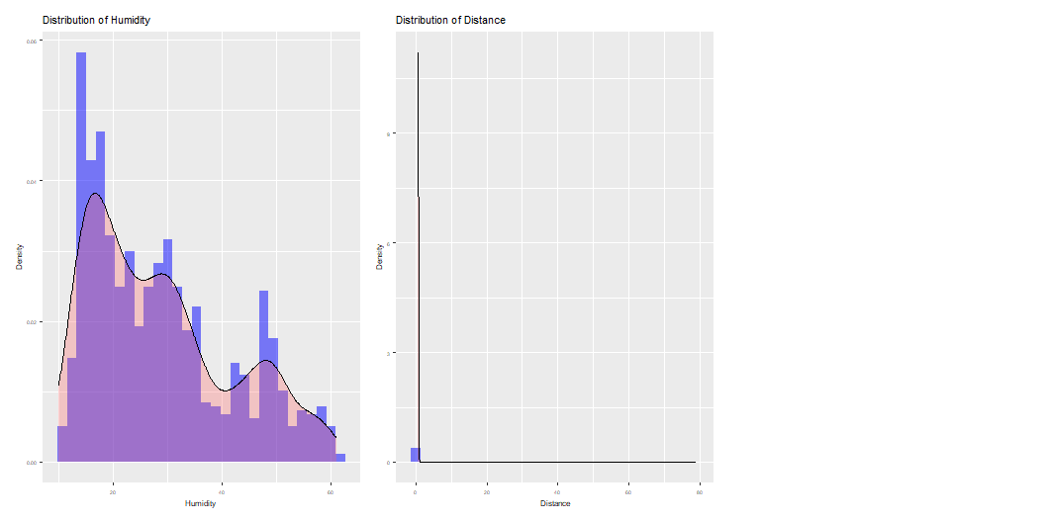
Plot Numerical Data

Slide 14

Dealing the Outlier
Interquartile Range (IQR)
$$\text{IQR}=Q3−Q1$$
Lower Bound
$$lower_{−}bound=Q1−1.5×IQR$$
Upper Bound
$$upper_{−}bound=Q3+1.5×IQR$$

Slide 15
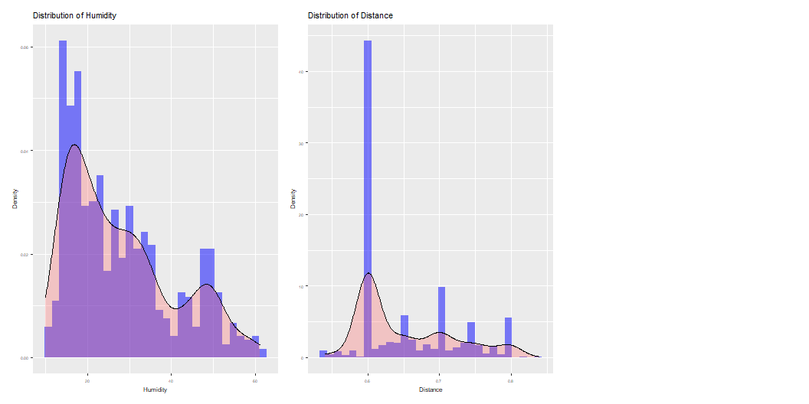
Plot Numerical Data w/o Outliers

Slide 16
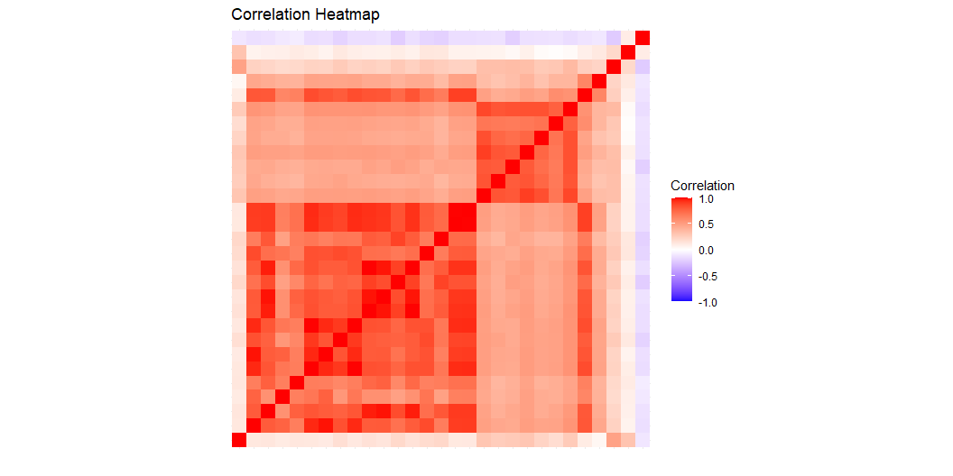
Correlation Matrix Heatmap

Slide 17
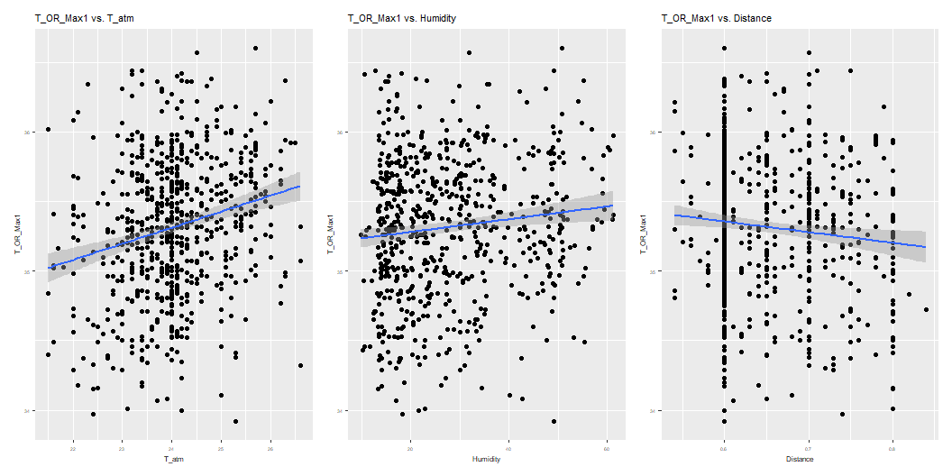
Oral Temperature VS. Dependent Variables

Slide 18
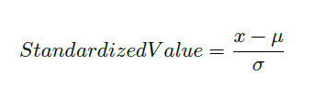
Standardization of Data

Slide 19
Split Data for Training and Testing by the Ration 80:20
set.seed(42) split <- sample.split(mydataframe$T_OR_Max1, SplitRatio = 0.8) train_data <- subset(mydataframe, split == TRUE) test_data <- subset(mydataframe, split == FALSE)

Slide 20
Full Liner Regression Model
lm(formula = T_OR_Max1 ~ ., data = train_data) Coefficients: Estimate Std. Error t value Pr(>|t|) (Intercept) -0.0403524 0.0426431 -0.946 0.34444 T_offset1 -0.1103248 0.0397636 -2.775 0.00572 ** Max1R13_1 -0.2336011 0.2270822 -1.029 0.30409 ... Distance -0.0241198 0.0357459 -0.675 0.50013 Gender_M 0.0580021 0.0727974 0.797 0.42595 --- Residual standard error: 0.7652 on 527 degrees of freedom Multiple R-squared: 0.4829, Adjusted R-squared: 0.4545 F-statistic: 16.97 on 29 and 527 DF, p-value: < 2.2e-16

Slide 21
Full Regression and Stepwised Regression Model
Add interaction terms (for two predictors only) to the full linear model increases the R-squared value, bringing it closer to 1. However, it also significantly increases the model’s complexity. In our case, with 435 factors (29 dependent variables and 406 interaction terms) involved, this suggests potential overfitting.
A stepwise method (backward) provides a way to remove predictors from the full regression model above to reduce complexity. However, the resulting model formula remains overly complicated.

Slide 22
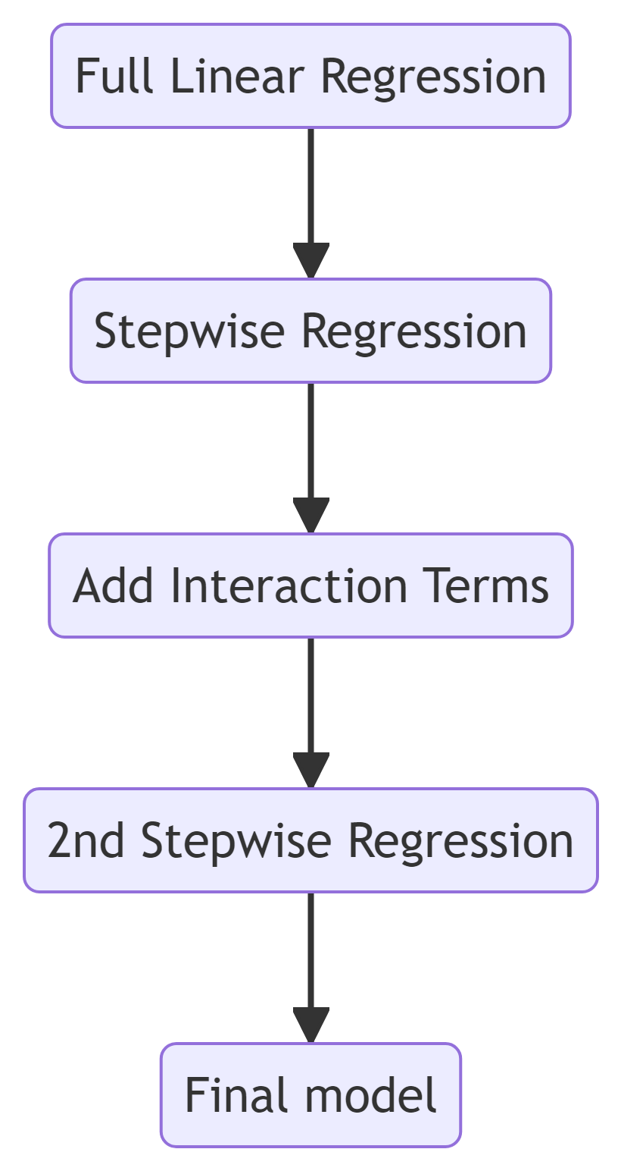
Improved Regression Model

Slide 23
Summary of the Improved Regression Model
lm(formula = T_OR_Max1 ~ T_offset1 + Max1R13_1 + aveAllR13_1 + T_RC_Dry1 + T_RC_Wet1 + canthi4Max1 + T_FHBC1 + T_FH_Max1 + T_Max1 + T_atm + Humidity + T_offset1:aveAllR13_1 + T_offset1:T_FHBC1 + T_offset1:T_atm + aveAllR13_1:T_FHBC1 + aveAllR13_1:Humidity + T_RC_Dry1:canthi4Max1 + T_RC_Dry1:T_FHBC1 + T_RC_Dry1:T_Max1 + T_RC_Dry1:Humidity + T_RC_Wet1:canthi4Max1 + T_RC_Wet1:T_Max1 + T_RC_Wet1:T_atm + T_RC_Wet1:Humidity + canthi4Max1:T_FH_Max1 + T_FHBC1:Humidity + T_FH_Max1:T_Max1 + T_FH_Max1:T_atm + T_Max1:T_atm, data = train_data) Multiple R-squared: 0.5667, Adjusted R-squared: 0.5428 p-value: < 2.2e-16
VIF: Max1R13_1 T_RC_Dry1:canthi4Max1 T_RC_Dry1:T_Max1 T_RC_Wet1:canthi4Max1 T_RC_Wet1:T_Max1 41.989761 35.459508 33.710904 29.592164 27.806219

Slide 24
Impove the Model with PCA
Principal Component Analysis (PCA) transforms the predictors into a set of uncorrelated components, reducing the number of variables without losing much information. Using too many predictors can lead to overfitting and complicate the interpretation of the analysis.

Slide 25
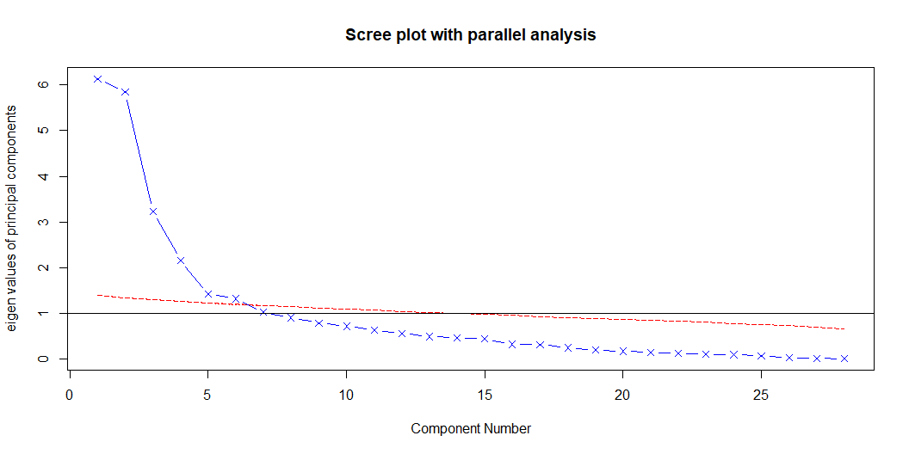
scree plot

Slide 26
components contributtion
[1] "Accumulated contribution up to component 1 : 34.47 %" [1] "Accumulated contribution up to component 2 : 51.43 %" [1] "Accumulated contribution up to component 3 : 60.94 %" [1] "Accumulated contribution up to component 4 : 67.42 %" [1] "Accumulated contribution up to component 5 : 71.8 %" [1] "Accumulated contribution up to component 6 : 75.81 %" ... [1] "Accumulated contribution up to component 26 : 99.92 %" [1] "Accumulated contribution up to component 27 : 99.97 %" [1] "Accumulated contribution up to component 28 : 100 %"

Slide 27
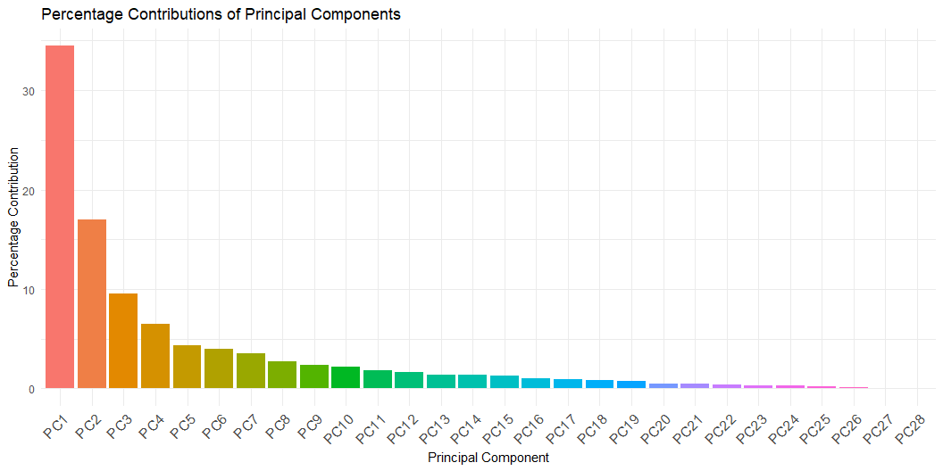
components contributtion continued

Slide 28
linear model with six components
lm(formula = T_OR_Max1 ~ ., data = train_data_pca) Coefficients: Estimate Std. Error t value Pr(>|t|) (Intercept) 0.010084 0.046457 0.217 0.8282 PC1 -0.007296 0.013137 -0.555 0.5788 PC2 0.235647 0.014889 15.827 <2e-16 *** PC3 -0.039088 0.019824 -1.972 0.0491 * PC4 -0.018475 0.024275 -0.761 0.4470 PC5 0.055235 0.029022 1.903 0.0575 . PC6 -0.030685 0.030082 -1.020 0.3082 --- Residual standard error: 0.8583 on 550 degrees of freedom Multiple R-squared: 0.321, Adjusted R-squared: 0.3136 F-statistic: 43.34 on 6 and 550 DF, p-value: < 2.2e-16
PC1 PC2 PC3 PC4 PC5 PC6 1.016655 1.002594 1.000763 1.006119 1.011774 1.001972

Slide 29
Ridge Regression
Ridge Regression adds a penalty equal to the square of the magnitude of the coefficients, helping to reduce the impact of multicollinearity.
# Ridge Regression set.seed(42) ridge_model <- cv.glmnet(x_train, y_train, alpha = 0) # alpha = 0 for ridge best_lambda_ridge <- ridge_model$lambda.min # Fit the final ridge model ridge_final <- glmnet(x_train, y_train, alpha = 0, lambda = best_lambda_ridge) # Extract coefficients ridge_coefficients <- coef(ridge_final) # Construct the equation intercept <- ridge_coefficients[1] # Intercept coefficients <- ridge_coefficients[-1] # Coefficients for predictors predictor_names <- colnames(x_train)

Slide 30
Ridge Regression Equation
Ridge Regression Equation:
T_OR_Max1 = 0.08592975 + (-0.0947 * T_offset1) + (-0.0980 * Max1R13_1) + (0.0915 * aveAllR13_1) + (0.0285 * T_RC_Dry1) + (0.0537 * T_RC_Wet1) + (-0.2444 * canthi4Max1) + (0.1146 * T_FHBC1) + (-0.0107 * T_FH_Max1) + (0.7387 * T_Max1) + (0.0816 * T_atm) + (0.0954 * Humidity) + (0.0633 * T_offset1:aveAllR13_1) + (-0.0413 * T_offset1:T_FHBC1) + (-0.0616 * T_offset1:T_atm) + (-0.0877 * aveAllR13_1:T_FHBC1) + (-0.0216 * aveAllR13_1:Humidity) + (-0.1070 * T_RC_Dry1:canthi4Max1) + (0.0682 * T_RC_Dry1:T_FHBC1) + (0.0109 * T_RC_Dry1:T_Max1) + (0.0773 * T_RC_Dry1:Humidity) + (-0.0570 * T_RC_Wet1:canthi4Max1) + (0.0374 * T_RC_Wet1:T_Max1) + (0.1129 * T_RC_Wet1:T_atm) + (-0.0950 * T_RC_Wet1:Humidity) + (0.2323 * canthi4Max1:T_FH_Max1) + (0.0393 * T_FHBC1:Humidity) + (-0.0784 * T_FH_Max1:T_Max1) + (-0.0311 * T_FH_Max1:T_atm) + (-0.0984 * T_Max1:T_atm)

Slide 31

Evaluate the model
$$RMSE=\sqrt{\frac{1}{n}\sum_{i=1}^{n}{{\left(\hat{y_{i}}−y_{i}\right)}^{2}}}$$
$$R^{2}=1−\frac{RSS}{TSS}$$
Caculated value based on Ridge model:
R-squared : 0.5144992
RMSE on Training Data: 0.7211868
RMSE on Testing Data: 0.7401346

Slide 32
Tools
R version 4.3.3 (2024-02-29 ucrt) -- "Angel Food Cake“ Copyright (C) 2024 The R Foundation for Statistical Computing Platform: x86_64-w64-mingw32/x64 (64-bit)
Rstudio 2024.04.2 Build 764 © 2009-2024 Posit Software, PBC "Chocolate Cosmos" Release (e4392fc9, 2024-06-05) for windows
Quarto 1.4.554

Slide 33
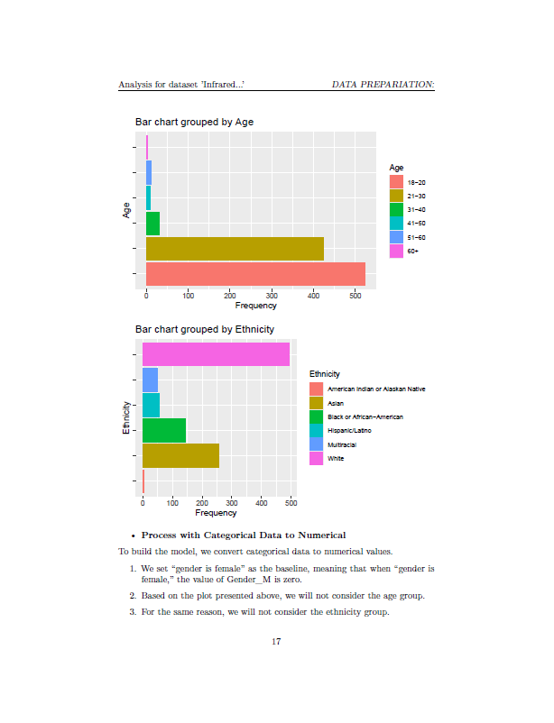
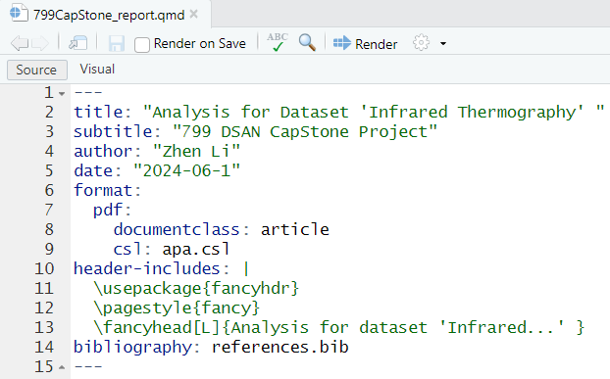
Quarto Example 1

Slide 34
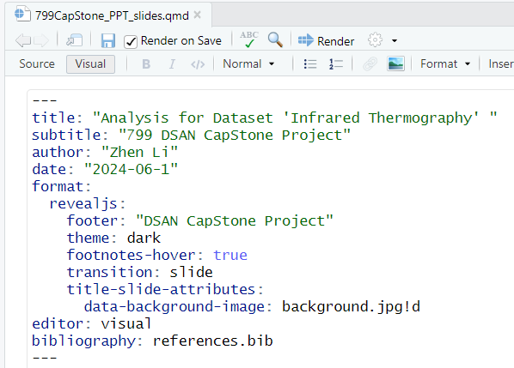
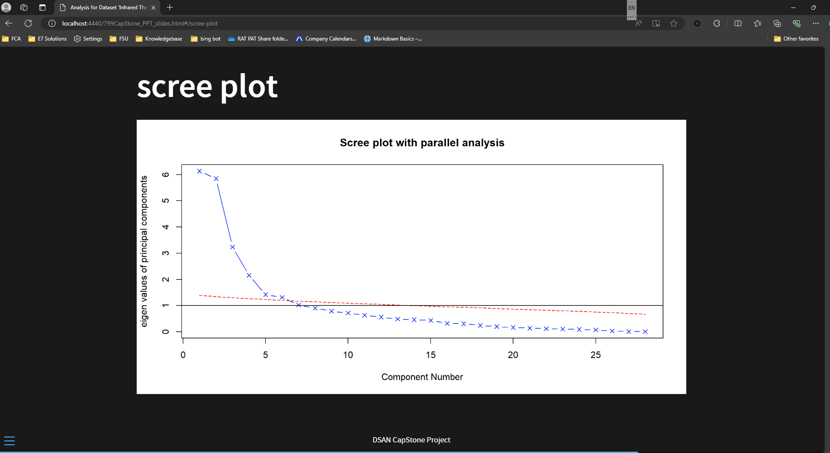
Quarto Example 2

Slide 35
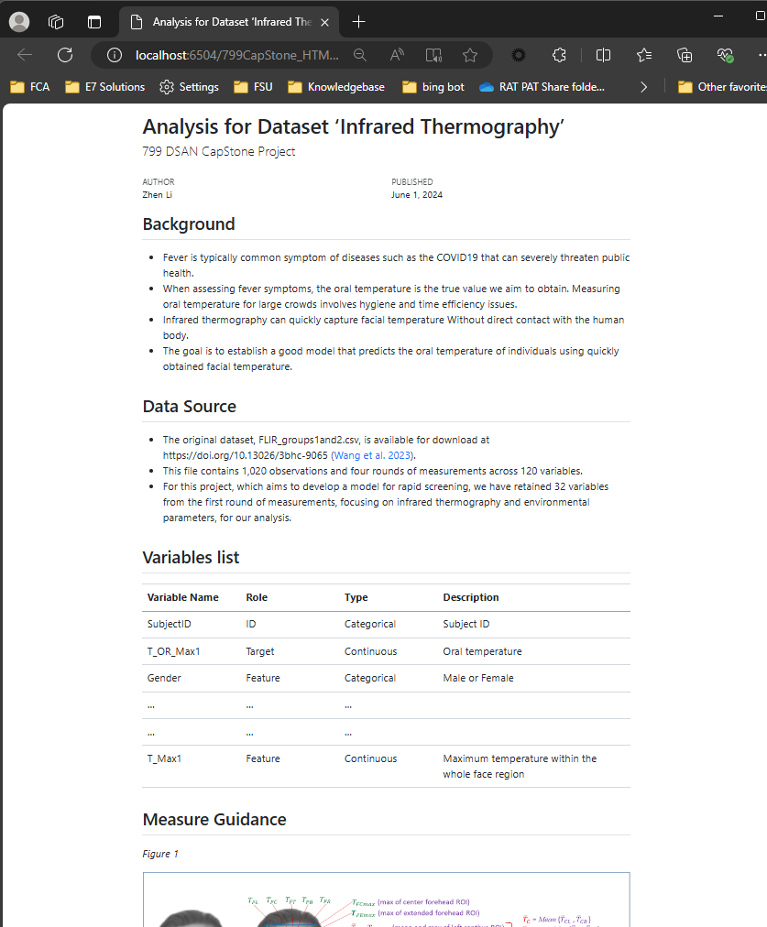
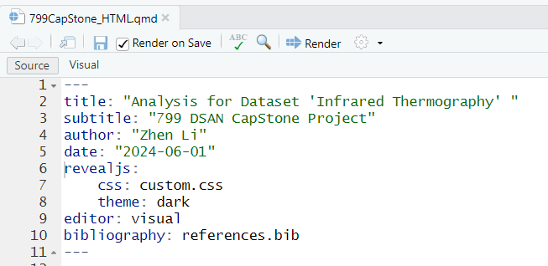
Quarto Example 3

Slide 36

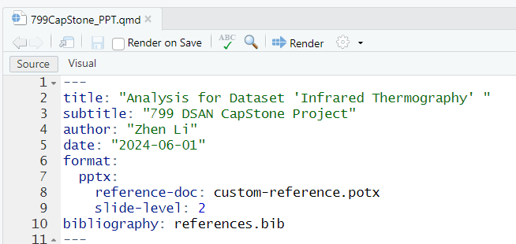
Quarto Example 4

Slide 37
Reference
Wang, Quanzeng, Yangling Zhou, Pedram Ghassemi, Divya Chenna, Meng Chen, Joseph Casamento, Trevor Pfefer, and David McBride. 2023. “Facial and Oral Temperature Data from a Large Set of Human Subject Volunteers (Version 1.0.0).” PhysioNet. https://doi.org/10.13026/3bhc-9065.
Markdown Basics – Quarto
https://quarto.org/docs/authoring/markdown-basics.html#text-formatting

Slide 38
Thank you!

